Slide 1
Predicting 2018/2020 Olympic

Slide 2
Outline
Data cleaning and preparation of data
Basic Exploration of dataset
Models used
Time forecasting series (AR)
Logistic regression
Random forest clustering
Outcome of models
Conclusion

Slide 3
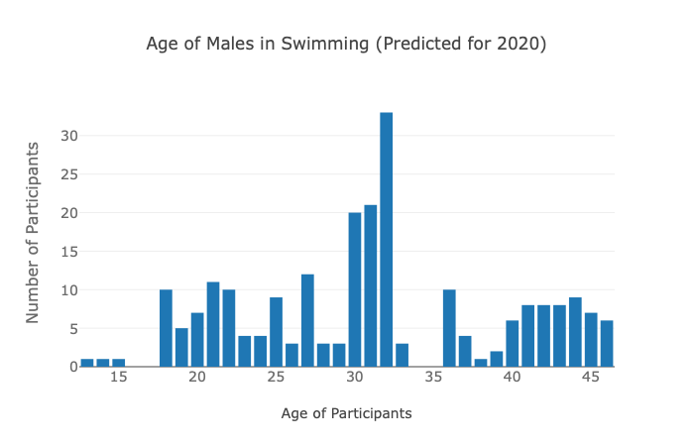
Problem Description
Predicting # of medallists for 2018/2020 based on age/height/weight distribution
Number of medallists

Slide 4
Data cleaning and preparation

Slide 5
What data?
Filling in of missing values in “Age”, “Height” and “Weight”
Filling in missing strings in “Region”
Removing individuals that are not relevant in today’s context
Adding Boolean values for each individual for “Gold”, ”Silver”, ”Bronze”
Adding in “Continents” based on the region of each individuals

Slide 6
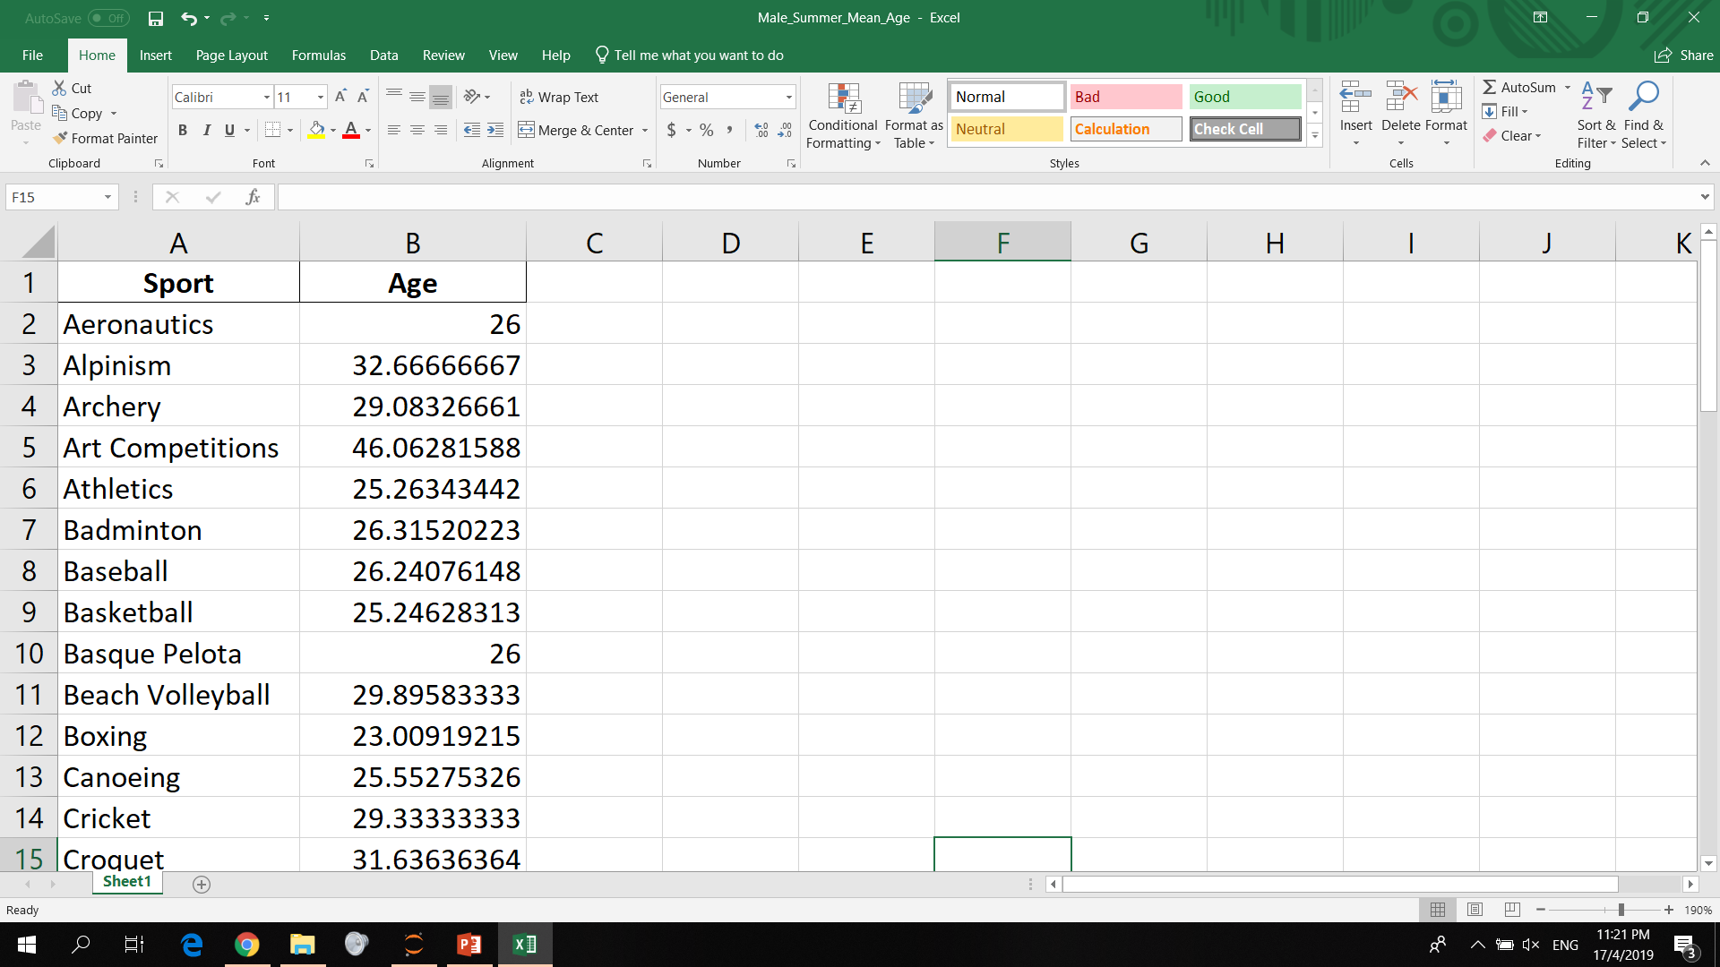
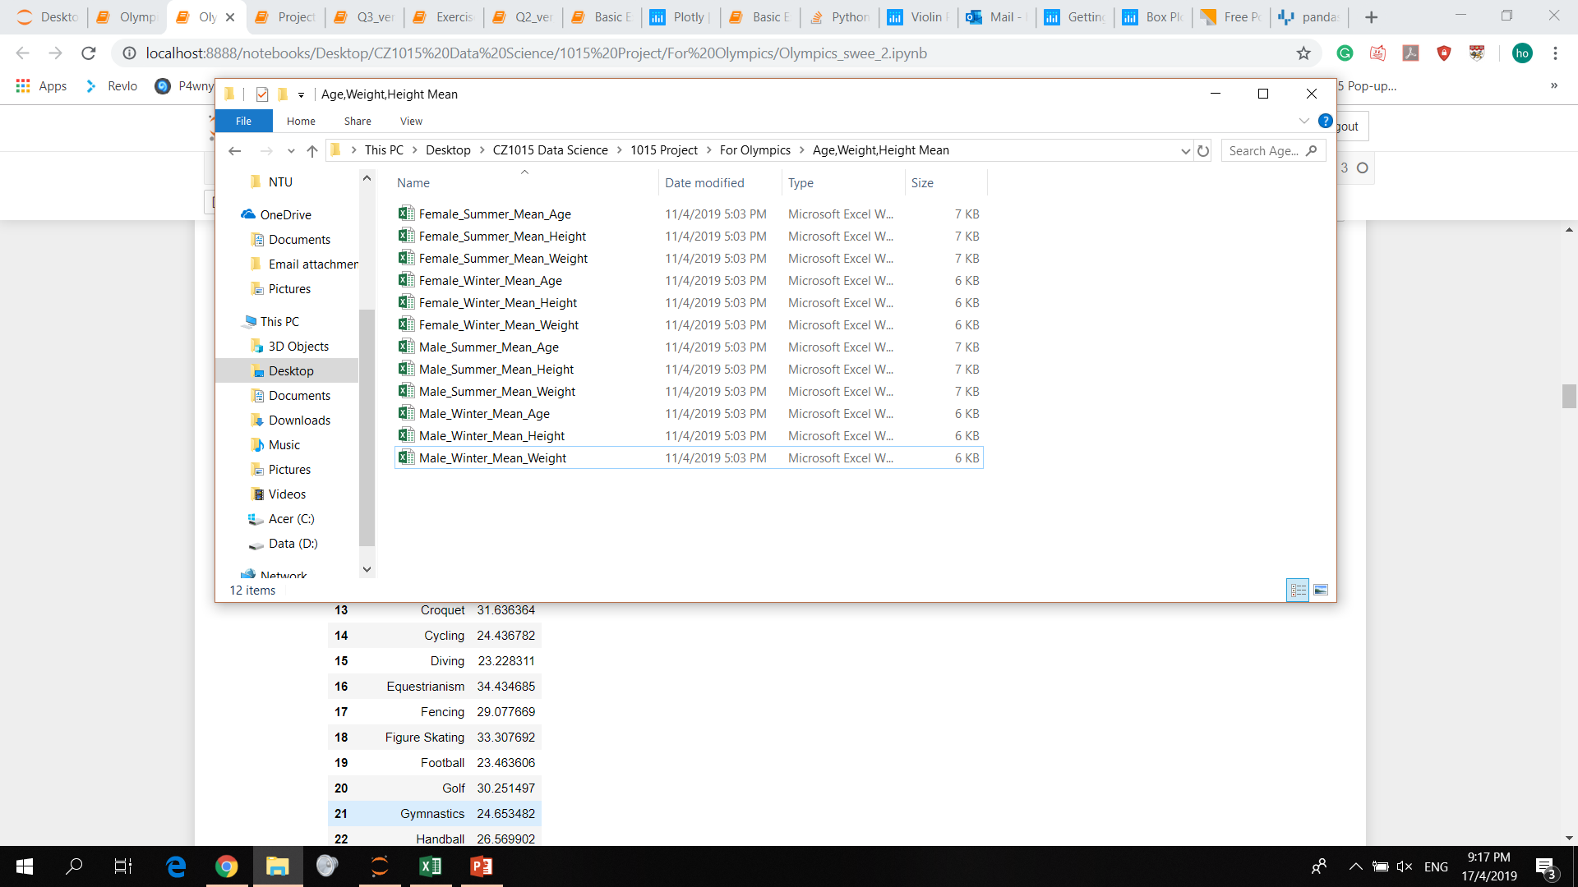
Filling in of missing values in “Age”, “Height” and “Weight”
For Male Summer

Slide 7
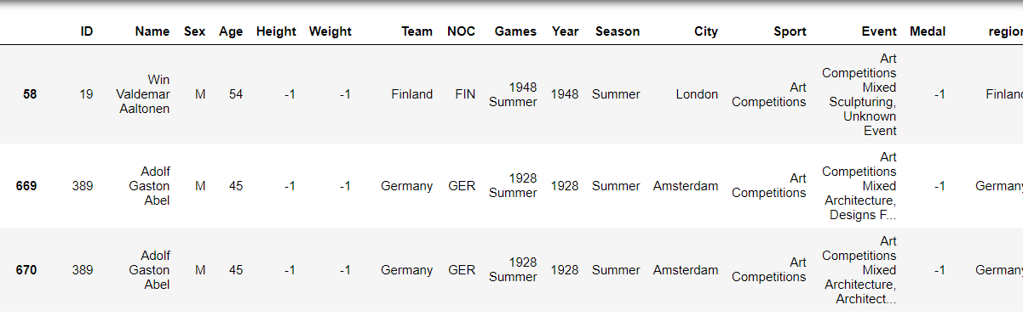
Removing individuals that are not relevant in our context

Slide 8
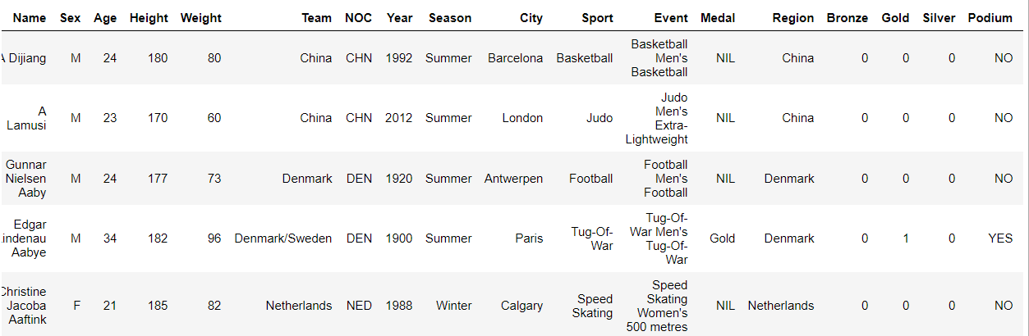
Adding Boolean values for each individual for “Gold”, ”Silver”, ”Bronze”

Slide 9
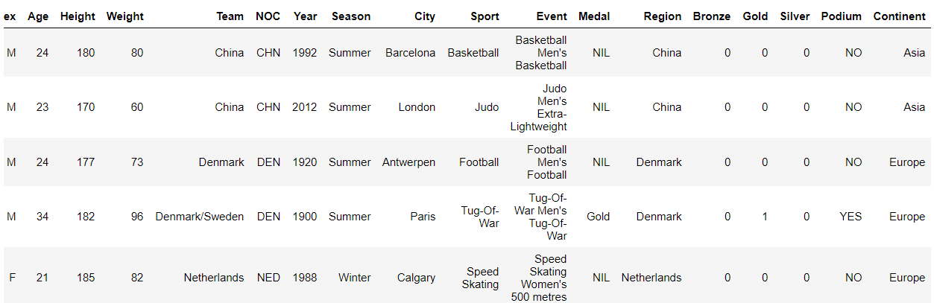
Adding in “Continents” based on the region of each individuals

Slide 10
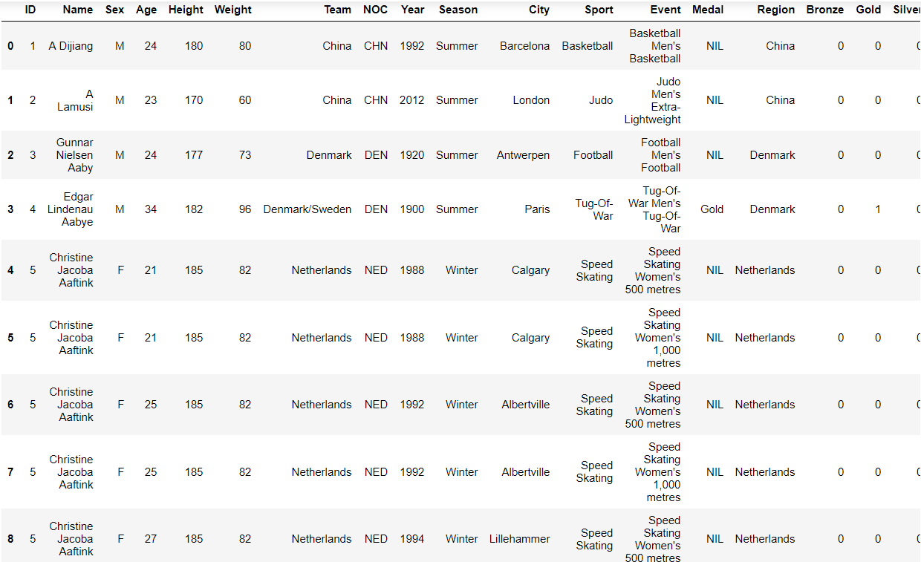
Removing duplicates of same ID

Slide 11
Basic exploration of dataset

Slide 12
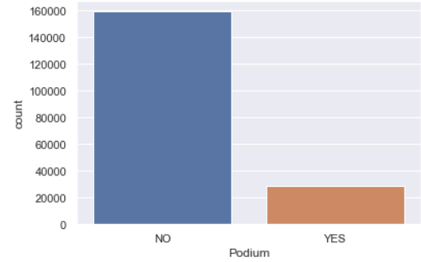
Athletics throughout the whole Olympic years

Slide 13
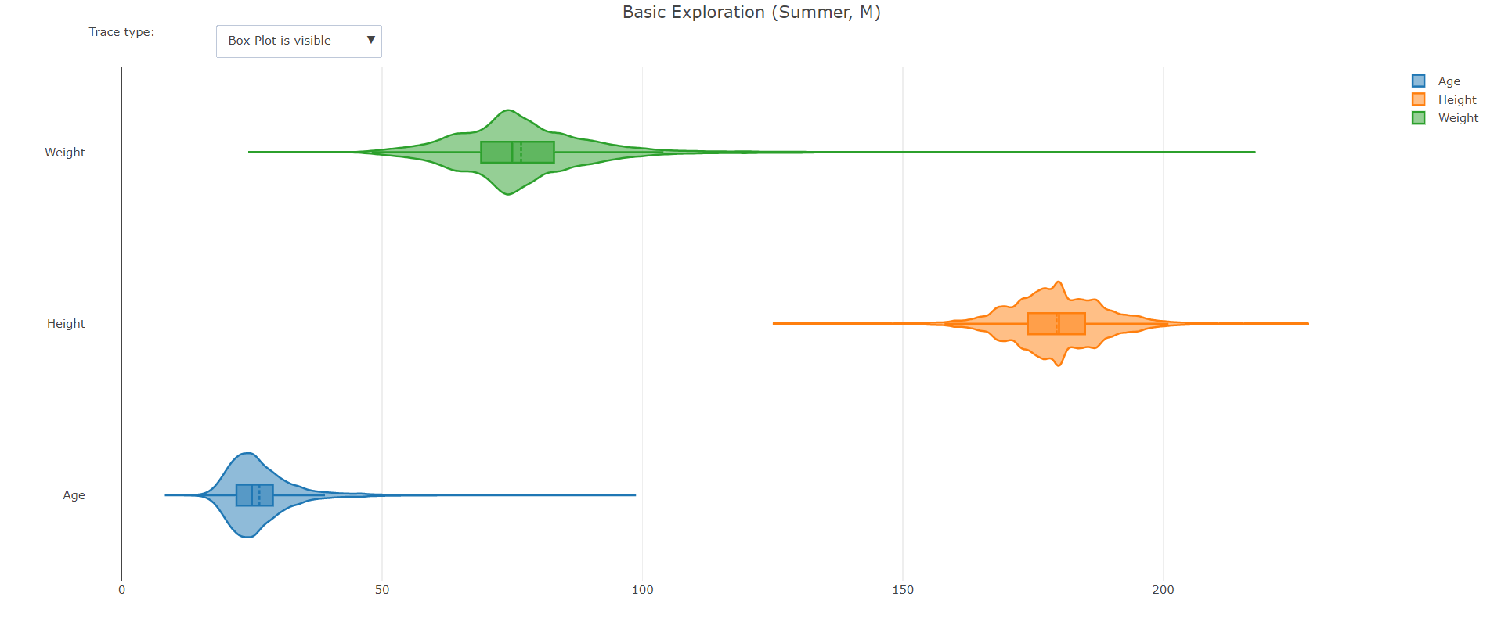
Basic visualisation
If you want to access it, you will have to go to the code manually

Slide 14
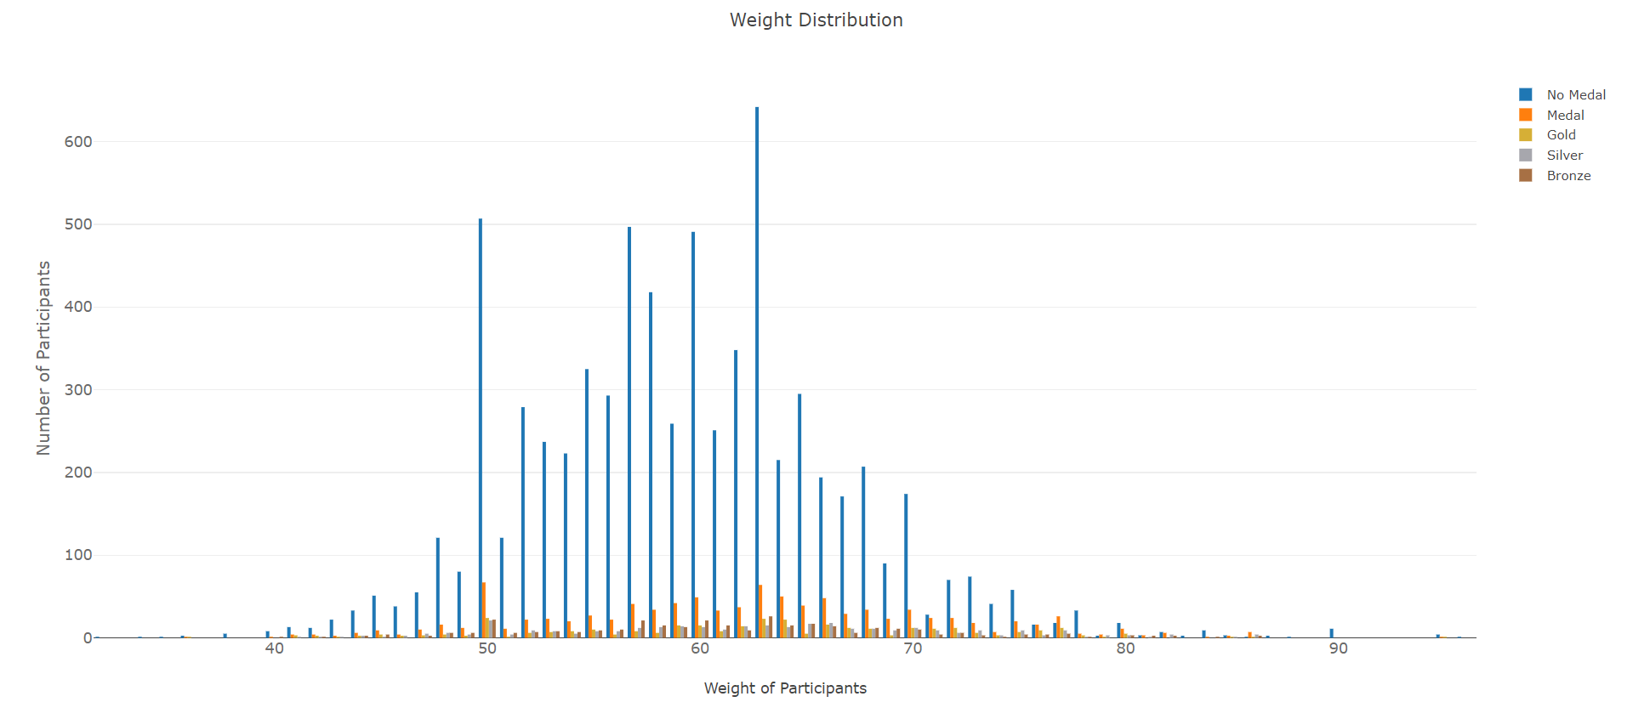
Bar chart visualisation
If you want to access it, you will have to go to the code manually

Slide 15
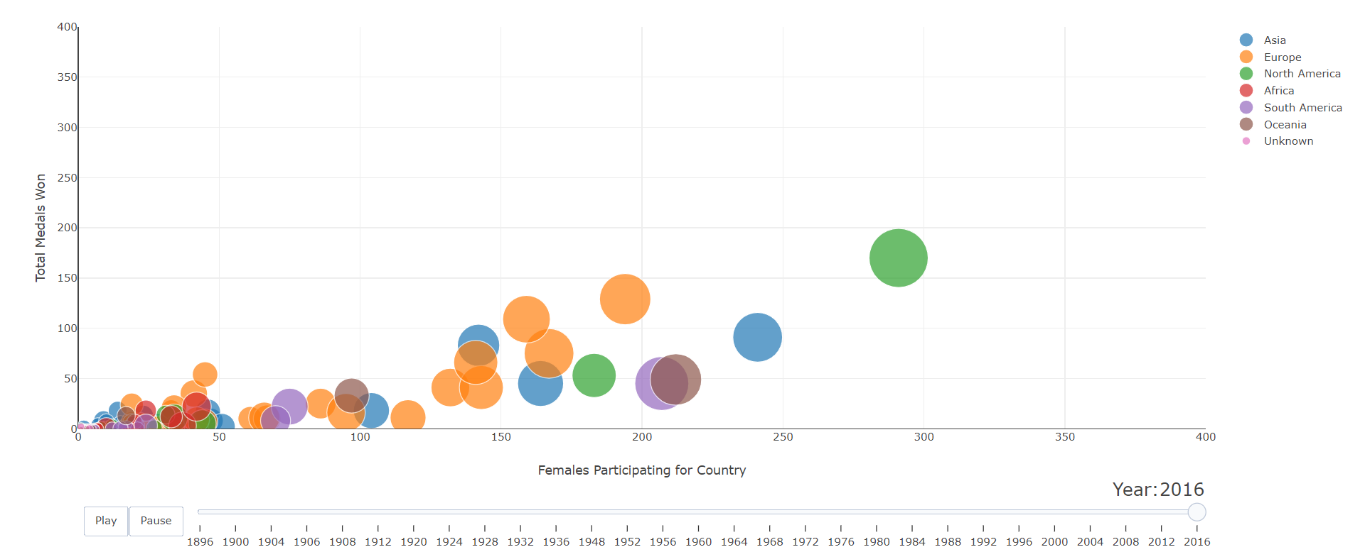
3-Variable plot
If you want to access it, you will have to go to the code manually

Slide 16
Models used for prediction

Slide 17
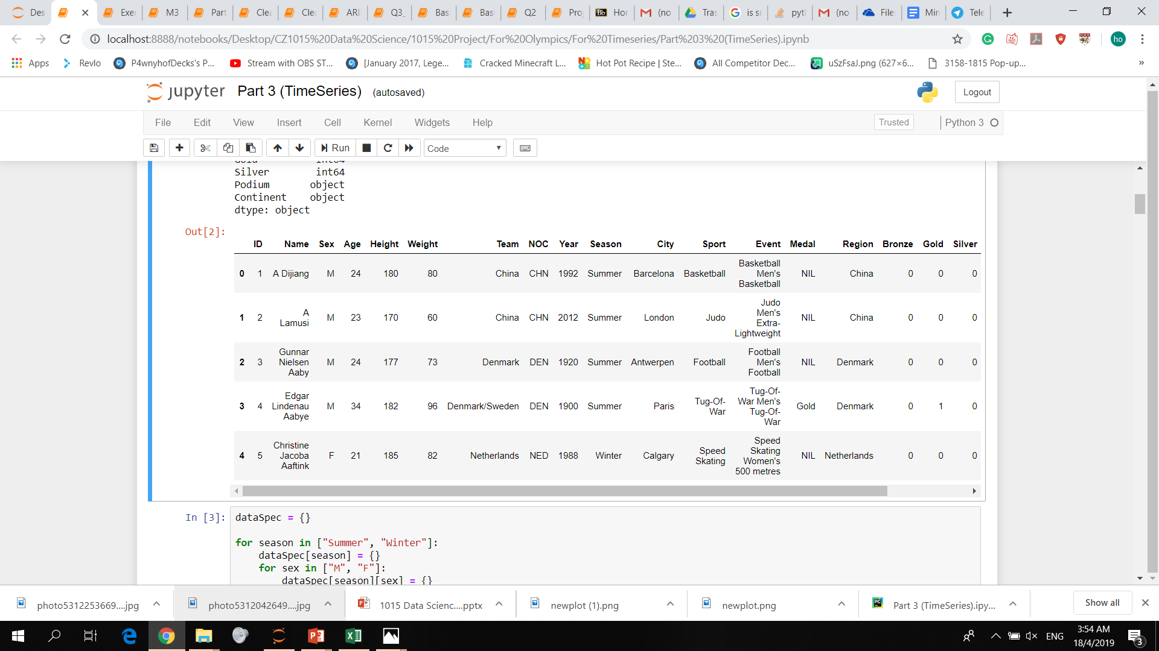
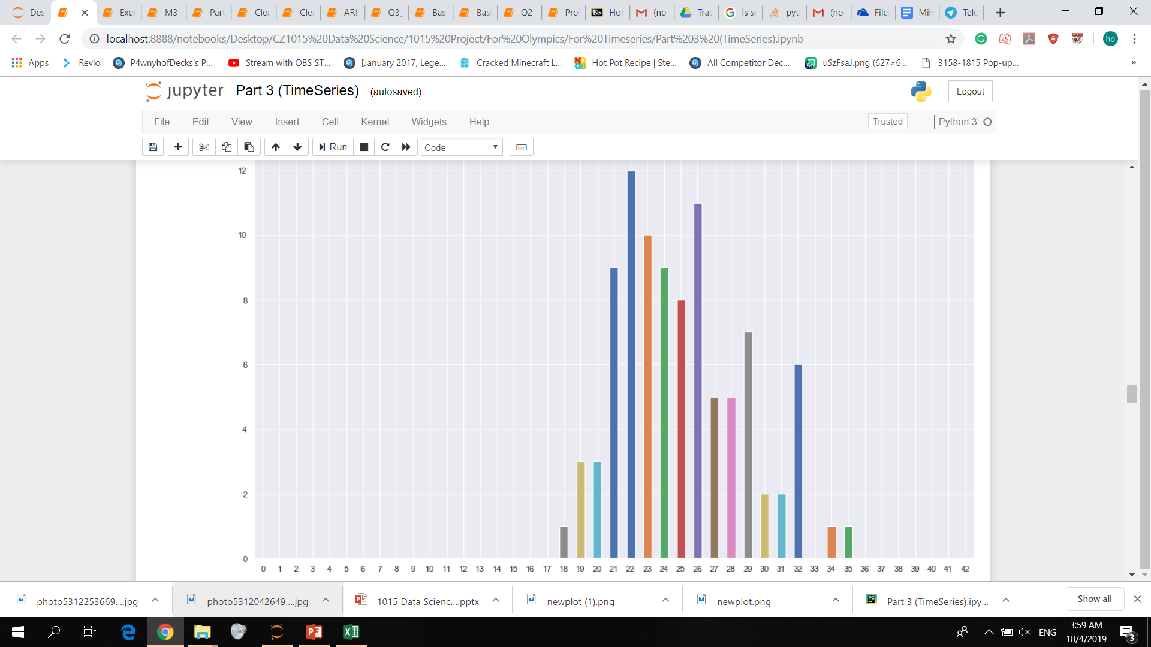
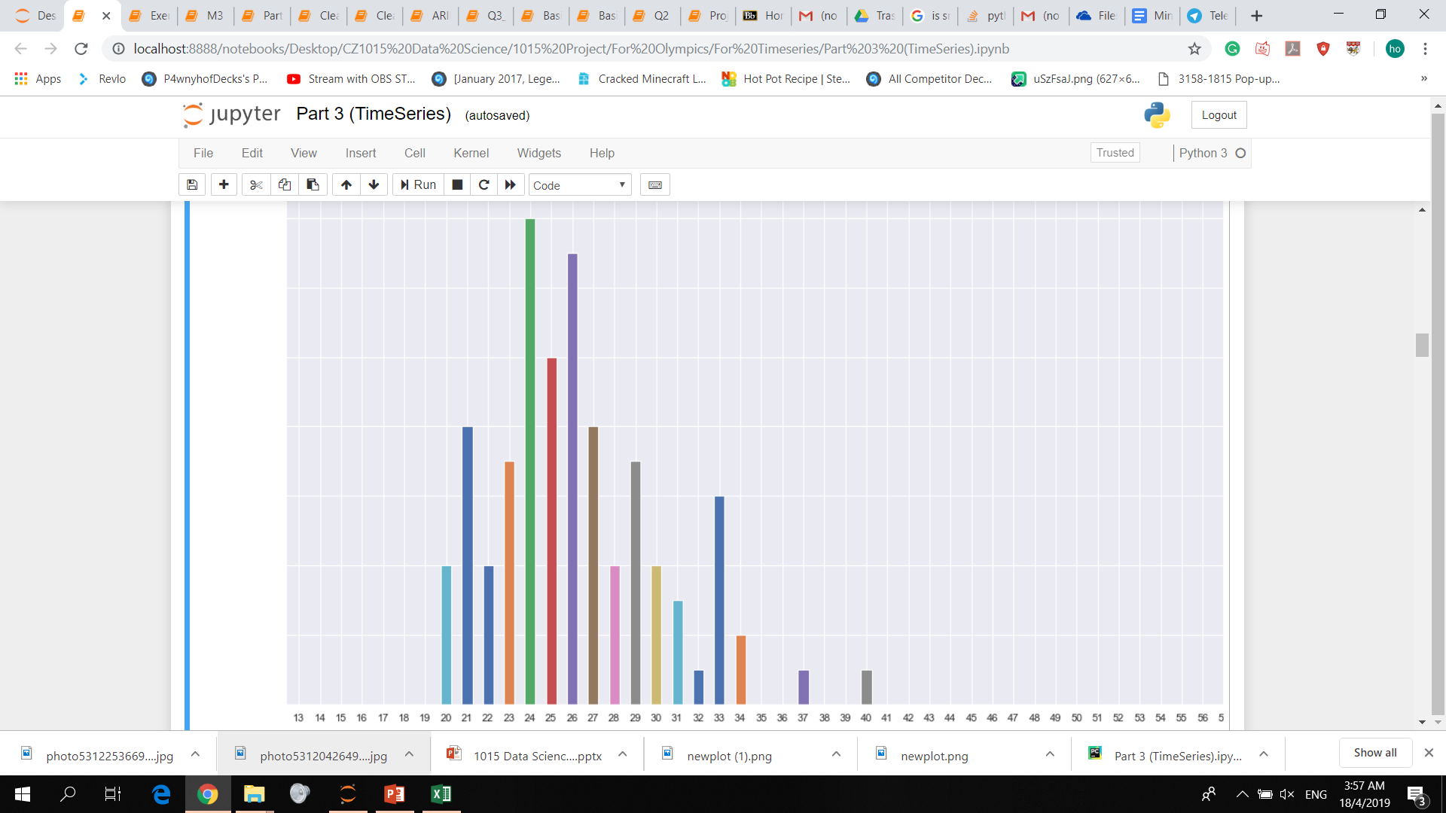
Time forecasting series
Predicted 2020 Athletics Male
2016 Athletics Male

Slide 18
Time forecasting series
Auto-Regression model
Predicting of next step based on previous time steps
Check for auto correlation

Slide 19
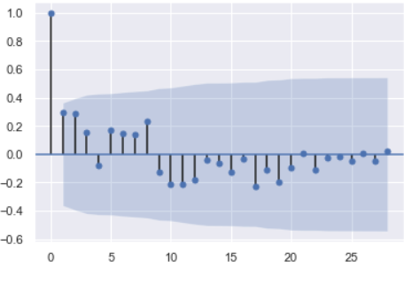
Auto correlation
For Swimming Male Summer Age 21

Slide 20
Problems of time series
Limited data → Bad correlation
Normally used for finance
Negative values

Slide 21
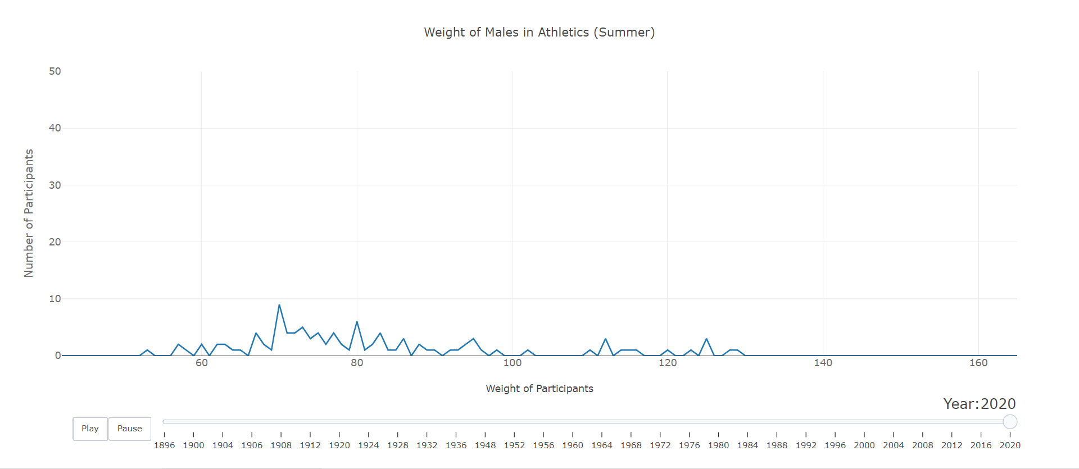

Slide 22
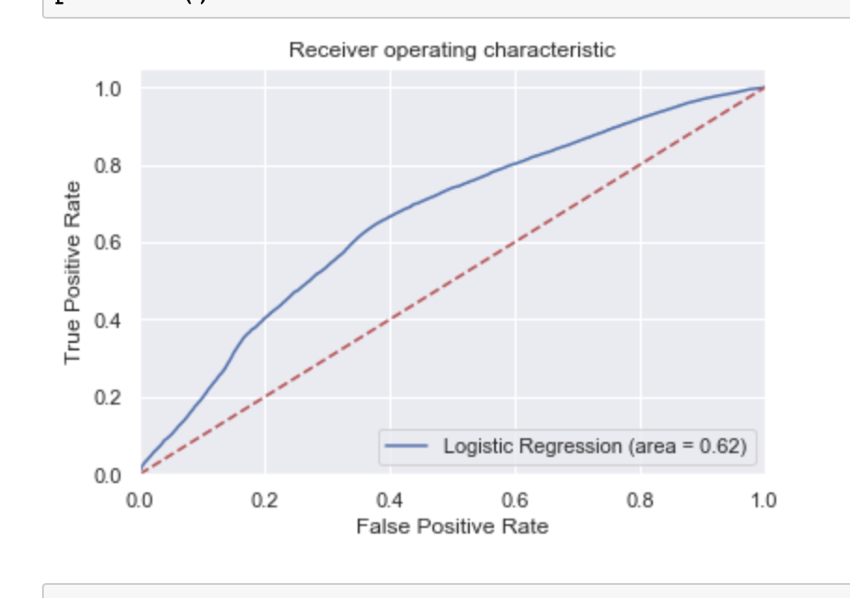
Logistic regression
Oversampling using SMOTE
Recursive Feature Elimination (RFE)
Accuracy: 62%

Slide 23

Random Forest Classifier

Slide 24
Time Forecasting Series vs Random Forest
Time Forecasting Series (AR)
Well-dispersed
Limited number of sports to predict
Limited data
Problems with accuracy
AIC=2.38
Random Forest
(sklearn)
Predicted by Probability
Any sport
More use of data
Faster
Affected by outliers
ACC=84%

Slide 25
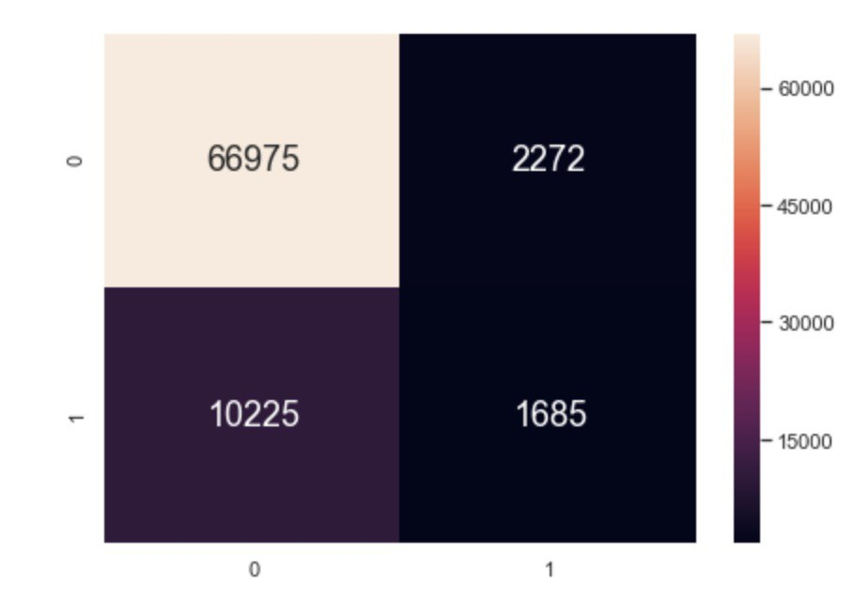
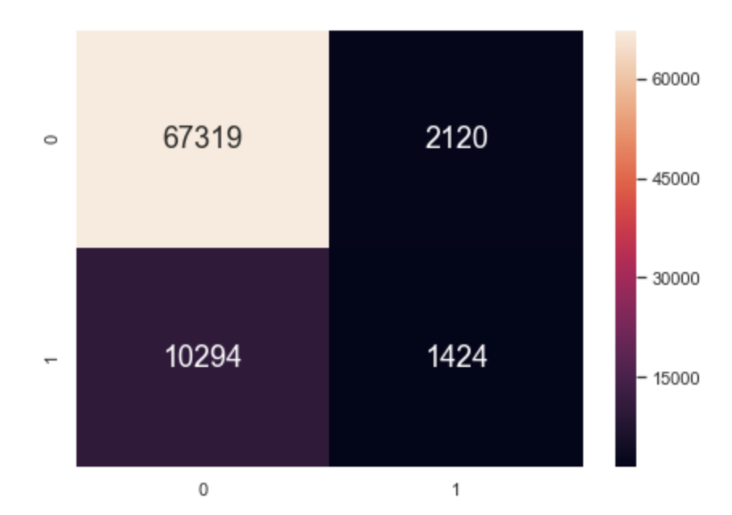
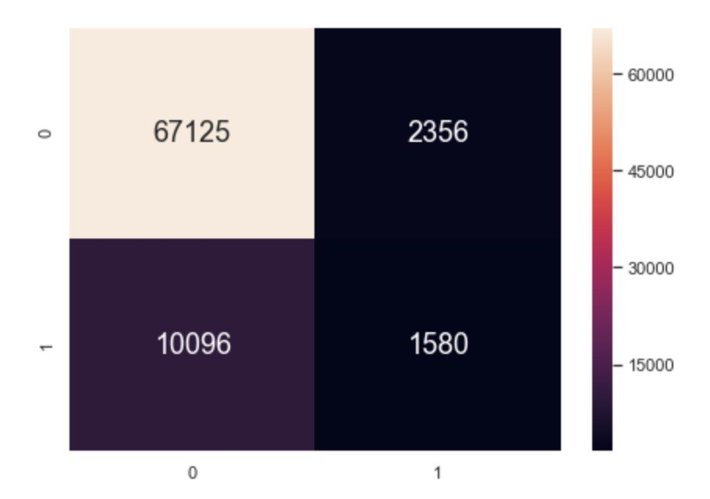
Confusion matrix
classifier(weight, gender, year, sport))
classifier(height, gender, year, sport))
classifier(age, gender, year, sport))

Slide 26
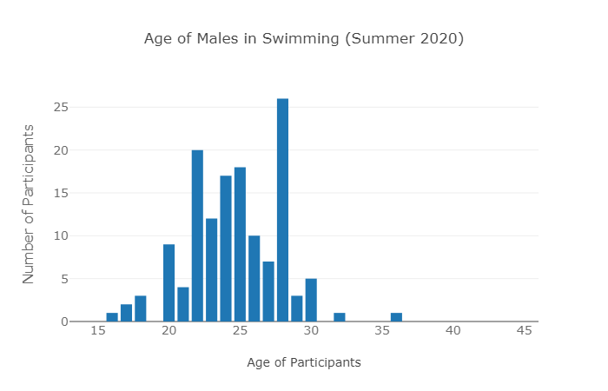
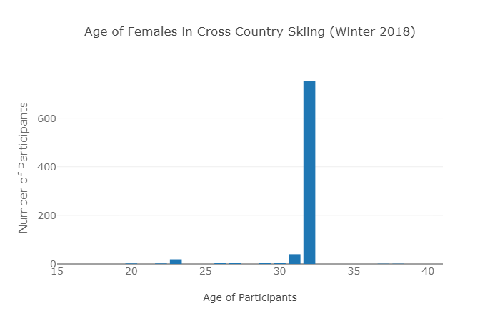
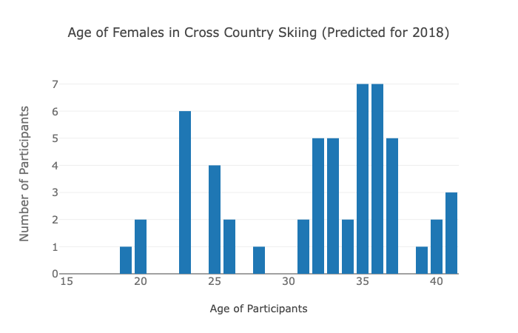
Time Series
Random Forest
Number of medallists
Number of medallists

Slide 27
Conclusion
Distribution can be predicted
More data -> More accurate
Male Data > Female Data
TS is well spread out
RF is more accurate

Slide 28
Lessons Learnt
Models
Time forecasting series
Logistic regression(sklearn)
Random Forest(sklearn)
Coding
Cleaning/converting data
Working with big data
Comparing models
Visualisation (plotly)
Sliders(Timeline)
Buttons
Dropdown box

Slide 29
Allocation of work
Cleaning/Preparing the data
Basic exploration
Time Forecasting Series
Random Forest Classifier
Swee
Swee/Nick
Swee
Nick
1
2
3
4

